Slide 1
Handling Events
Lesson 05

Slide 2
Lesson Objectives
Introduction
jQuery Event Model Benefits
Attach and detach Events from DOM Elements
Triggering Events
Passing data through events
Notes:
Explain the lesson coverage

Slide 3
5.1. Introduction
Introduction
All the different visitor's actions that a web page can respond to are called events.
An event represents the precise moment when something happens.
Examples:
      moving a mouse over an element
      selecting a radio button
      clicking on an element
Notes:
Additional notes for instructor

Slide 4
5.2. jQuery Event Model Benefits jQuery Event Model Benefits
Events notify a program that a user performed some type of action
jQuery provides a cross-browser event model that works common across all browsers.
jQuery event model is simple to use and provides a compact syntax
Notes:
Additional notes for instructor

Slide 5

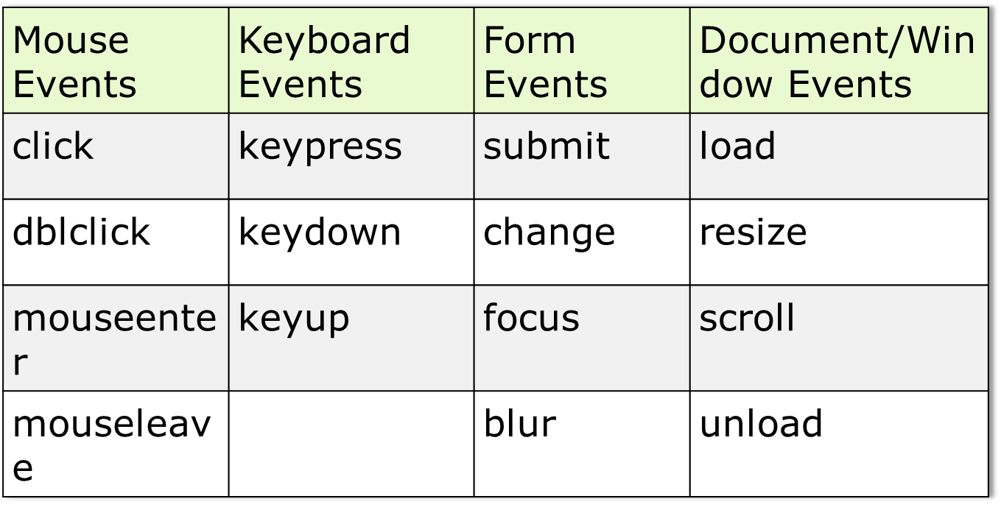
5.2. jQuery Event Model Benefits jQuery Events
Notes:
Additional notes for instructor

Slide 6
5.3. Attach and detach Events from DOM Elements bind() and unbind() method
bind() method is used to bind events dynamically
.bind(eventType,handler(eventObject)) attaches a handler to an event for the selected element(s).
      $(‘#submitButton’).bind('click', function() { //handle event });
  .click() is the same as .bind('click')
.unbind(event) is used to remove handler previously bound to an element.
      $(‘#submitButton’).unbind();
      $(‘#submitButton’).unbind('click'); - unbind specific event
bind() allows multiple events to be bound to one or more elements
      $(‘#targetDiv’).bind('mouseenter mouseleave', function() { //handle event });
Notes:
Additional notes for instructor

Slide 7
5.3. Attach and detach Events from DOM Elements on() method
on() method attaches an event handler function for one or more events to the selected elements
on() method can bind events to elements that don't exist yet which is called as event delegation.
      $('#target').on('click','.spl:button',sayHi);
  Above statement will attach sayHi() event handler function to the click event on the button with class spl. The button may be yet to append in the div with id target.
Notes:
Additional notes for instructor

Slide 8
5.3. Attach and detach Events from DOM Elements off() method
off() method removes event handlers that were attached with on()
      $('#target').off('click','.spl:button');
one() method especially useful if you need to do some complicated setup the first time an element is clicked, but not subsequent times. It accepts the same arguments as .on()
Notes:
Additional notes for instructor

Slide 9
5.4. Triggering Events
Triggering Events
jQuery provides a way to trigger the event handlers bound to an element without any user interaction via the .trigger() method
      $( “#btn1” ).trigger( “click” );
  It will trigger the click event on element selected by id btn1
Notes:
Trigger() function can be used to trigger the predefined as well as user defined events.
$('#btnSecond').bind('karthikClick',function(event){
alert('Second Button Custom Event Occured');
});
. . .
$('#btnFirst').bind('click', function(){
$('#btnSecond').trigger('karthikClick);
});
Additional notes for instructor

Slide 10
5.5. Passing data through events
Passing data through events
While attaching the event, data in JSON form can be passed to event handler function which can be accessed through event.data property
      $('#btnData').bind('click',{id:1},function(event){
  alert(event.data.id);
  });
Notes:
Additional notes for instructor

Slide 11
Summary
jQuery simplifies handling cross-browser event attachments
bind() and unbind() provide a flexible way to work with different events
on() allows future child elements to be wired to event handlers
one() allows elements to be wired to event handlers for one time event handling
trigger() allows to trigger the event
Notes:
Add the notes here.
Additional notes for instructor

Slide 12
Lab
5.1. Adding and Removing Style at runtime using Click Event
5.2. Preventing Cut-Copy-Paste in textbox
5.3. Identifying mouse button
5.4. Limiting number of characters in textarea
5.5. Check/Uncheck all checkboxes at once
5.6. Event Triggering
Notes:
Add the notes here.
Additional notes for instructor

Slide 13
Review Question
What does the following statement do:
      $('#myDiv').bind('click',function(){// do something});
  It attaches the event handler function to click event on element selected by #myDiv
  It triggers the click event on the element selected by #myDiv.
What does this do: $('#myDiv').trigger('click');
  It simulates a click on the element and runs all the event handlers associated with it.
  It sets up a trigger. When a click occurs, the trigger is going to be activated.
Notes:
Add the notes here.
Answers for the Review Question 1: A
Question 2: A

